Slide 1
Self-State Identification and Classification in Mental Health Data using Agentic AI Systems
Course: DSL501
Team : Ashutosh Kumar Jha (12340390)
Date: 02/09/2025

Slide 2
Table of Contents
Introduction to the Problem Statement
Domain fundamentals and Related Work/Literature Review
Main Reference Methodology
Novelty
Experiments timeline
Compute Requirements

Slide 3
Introduction to the Problem Statement
Self-state identification (adaptive vs. maladaptive) is under-explored.
Lack of benchmarks, open-source code, and established ML pipelines.
Important for computational mental health linguistics and responsible AI.
Dataset: Reddit mental health posts (proxy for CLPsych 2025).

Slide 4
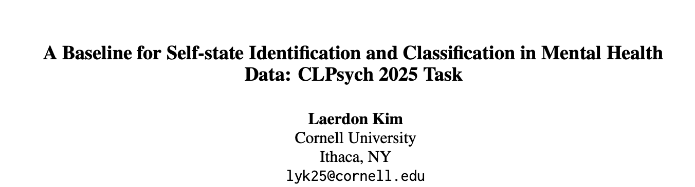
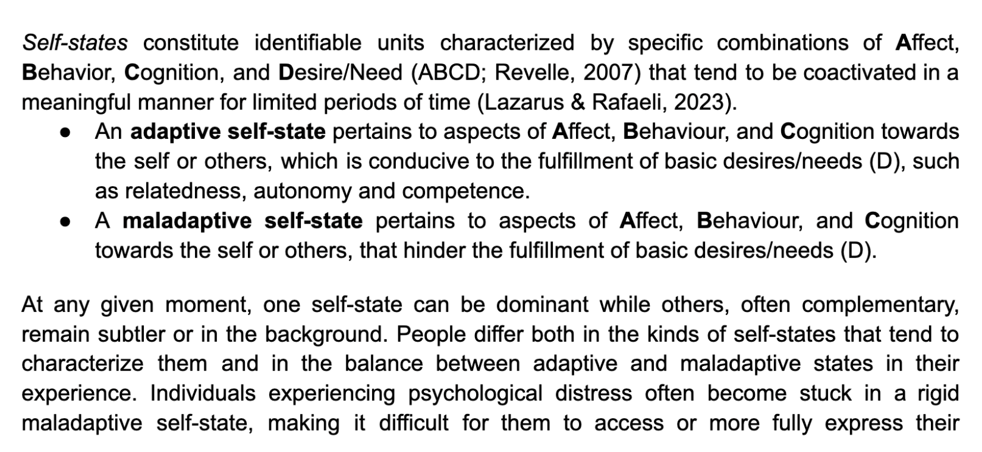
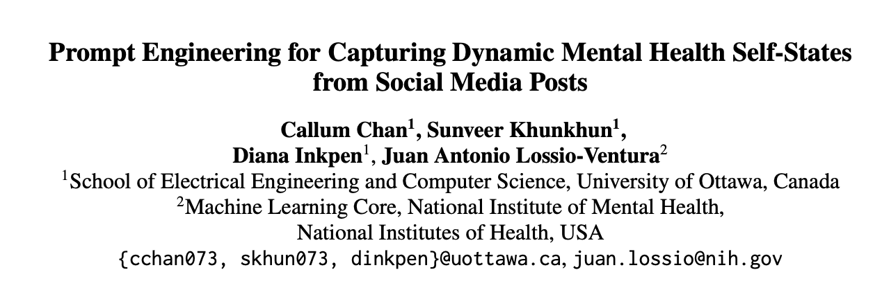
Domain fundamentals
[2] Kim, L. (2025). A baseline for self-state identification and classification in mental health data: CLPsych 2025 task. arXiv. https://arxiv.org/abs/2504.14066
[5] CLPsych 2025 Task Organizers. (2025). CLPsych 2025 Task Description. GitHub repository. https://github.com/Teo1230/clpsych25-task/blob/main/CLPsych%202025%20Task%20Description.pdf
[1] Chan, C., Khunkhun, S., Inkpen, D., & Lossio-Ventura, J. A. (2025). Prompt engineering for capturing dynamic mental health self states from social media posts. In A. Zirikly, A. Yates, B. Desmet, M. Ireland, S. Bedrick, S. MacAvaney, K. Bar, & Y. Ophir (Eds.), Proceedings of the 10th Workshop on Computational Linguistics and Clinical Psychology (CLPsych 2025) (pp. 256–267). Association for Computational Linguistics. https://doi.org/10.18653/v1/2025.clpsych-1.22

Slide 5
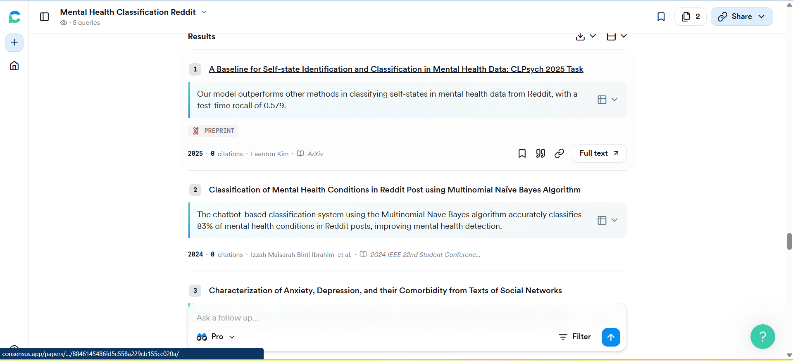
Literature review (1)

Slide 6
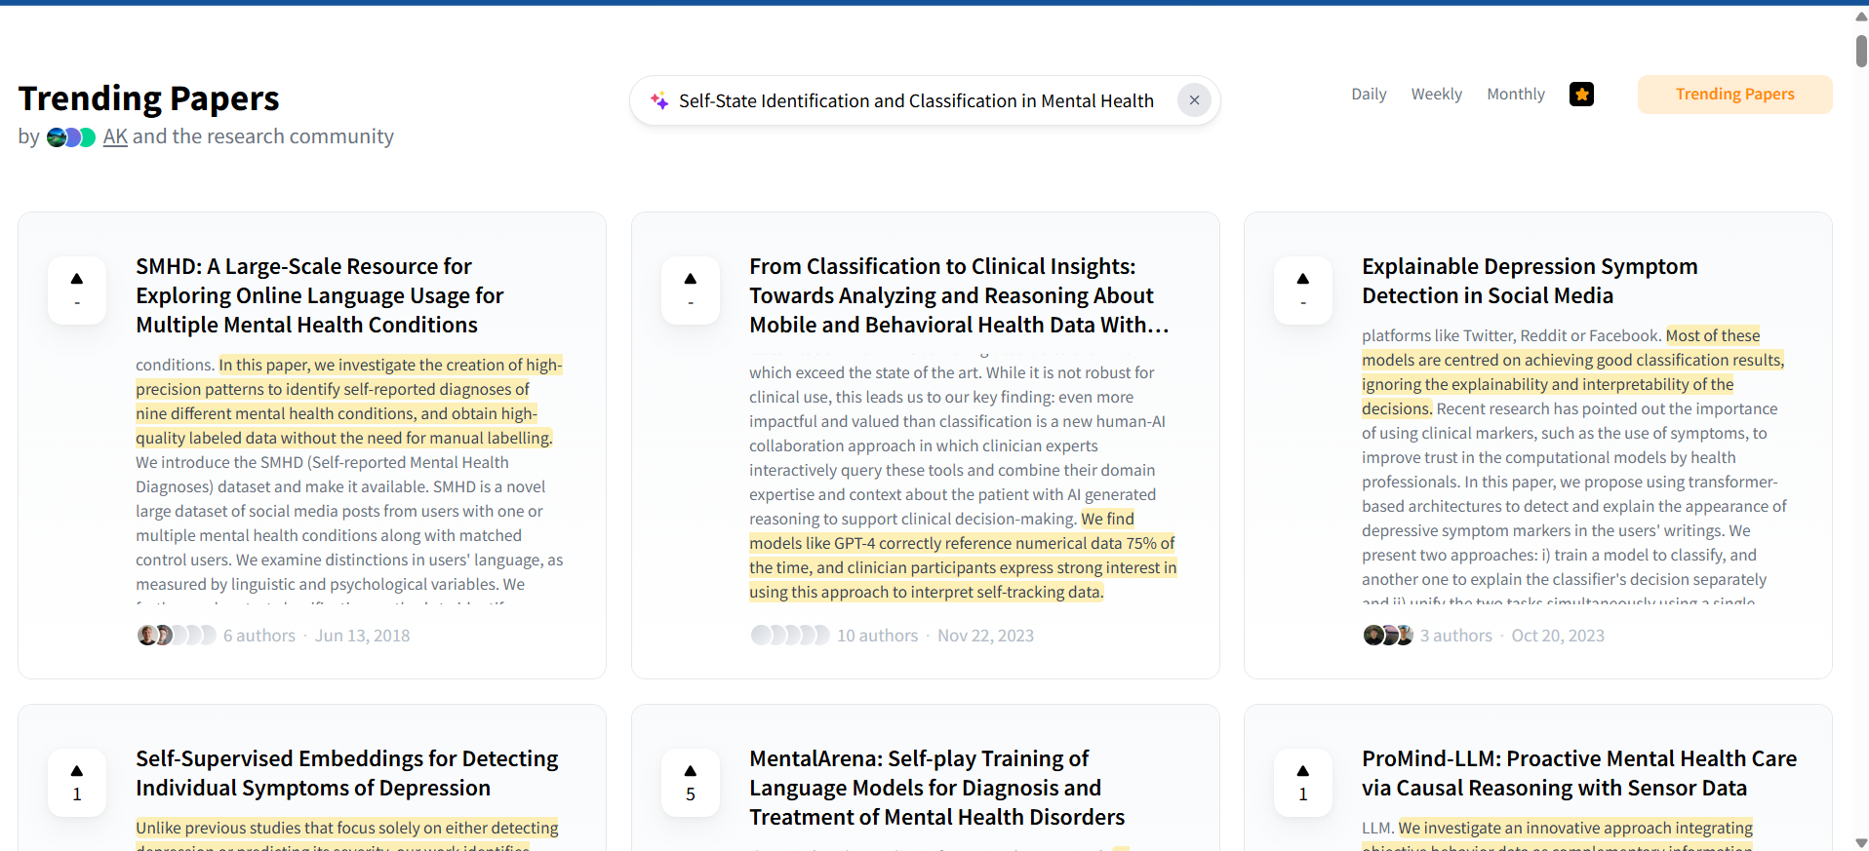
Literature review (2)

Slide 7
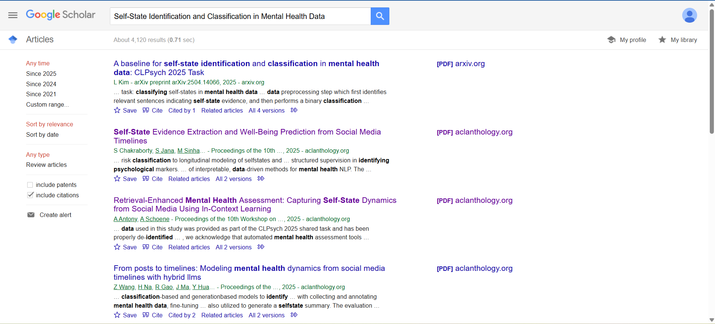
Literature review (3)

Slide 8
Baseline Description (2)
Preprocessing:
Contextualization:
Provided the model with context by including all previous sentences in the post.
Incorporated few-shot learning with examples of adaptive and maladaptive classifications.
LLM Span Identification:
Recognized that many self-state spans were sub-sentence level.
Identified 70.2% of maladaptive and 68.7% of adaptive self-states
Evaluation Metrics:
Recall-Oriented Performance:
Calculated using the average of the maximum pairwise BERT Score.
Weighted Recall:
Assessed systems based on the cumulative number of annotated tokens, aiming for similarity to human-annotated tokens
[2] (Section 3) Kim, L. (2025). A baseline for self-state identification and classification in mental health data: CLPsych 2025 task. arXiv. https://arxiv.org/abs/2504.14066

Slide 9
Baseline Description
Model:
Utilized a 4-bit quantized Gemma 2 9B model.
Employed few-shot learning without fine-tuning.
Preprocessing:
Sentence Splitting:
Applied spaCy for sentence segmentation.
Classified each sentence as adaptive or maladaptive.
Importance Filtering:
Implemented a preprocessing step using an LLM to determine sentence importance.
Focused on six MIND self-state dimensions: affective, behavior-self, behavior-others, cognition-self, cognition-others, and desire. at sub-sentence levels.
[2] (Section 3) Kim, L. (2025). A baseline for self-state identification and classification in mental health data: CLPsych 2025 task. arXiv. https://arxiv.org/abs/2504.14066

Slide 10
Novelty
Unlike traditional LLM-only systems for self-state identification and classification, this architecture leverages Agentic AI mechanisms for reasoning-based exploration of self-states [Chan et al., 2025; Kim, 2025].
Use of reasoning-enabled agents helps capture self-states more efficiently compared to single-pass LLM methods using “conversational states” and helps address LLM bias [Peters & Matz, 2024].
Instead of a single LLM component, multiple agents handle different tasks, maintaining modularity and separation of concerns in the architecture [Chan et al., 2025].
Since the code for the reference paper was not provided, implementation of the codebase, that too with a new architecture, can be termed as a novelty

Slide 11
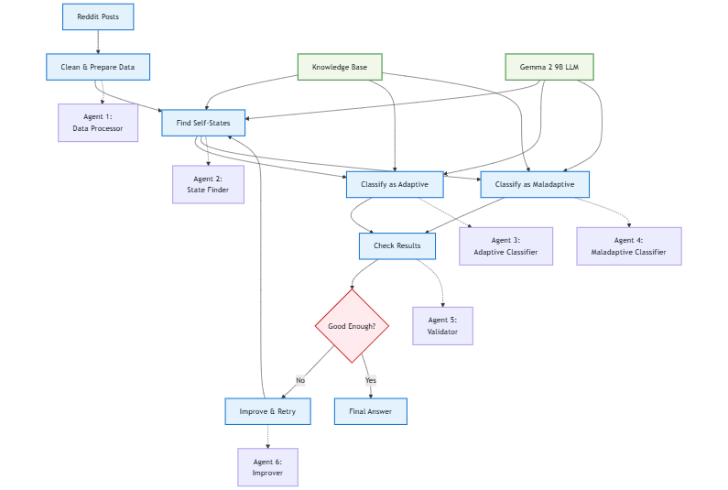
Architecture

Slide 12
Dataset
Since the official dataset pertaining to the reference paper is not available publicly, we will be collecting the data
The data will be collected using web scrapping, manual data loading, extracting the data from pre-scraped sources, etc.
Since the problem statement is based on inference and not on training, the amount of data needed will be probably less and therefore can be collected using the techniques mentioned above
Since the data collected from these sources can be in an inappropriate format, it will be preprocessed for maintaining data quality, format consistency, importance weightage, etc.
The size of the dataset will be used which is mentioned in the reference paper.

Slide 13
Experiments Timeline (Add dates here)
Implementation of baseline
Conversion to Agentic System
Potential Issues
Bias Reinforcement
LLM conversation Performace degradation

Slide 14
Compute Requirements
Hardware: GPU with ≥16GB memory (e.g., NVIDIA V100/A100 or whatever is available) for inference of quantized LLMs; high-RAM CPU for preprocessing tasks.
Software: Python (obviously), PyTorch, Hugging Face Transformers, spaCy, BERTScore, LangChain, LangGraph.
Additional Tools: Weights & Biases for experiment tracking, APIs for Reddit data collection, open-source LLM checkpoints (Gemma 2 9B, as used in the original paper).

Slide 15
References
Chan, C., Khunkhun, S., Inkpen, D., & Lossio-Ventura, J. A. (2025). Prompt engineering for capturing dynamic mental health self states from social media posts. In A. Zirikly, A. Yates, B. Desmet, M. Ireland, S. Bedrick, S. MacAvaney, K. Bar, & Y. Ophir (Eds.), Proceedings of the 10th Workshop on Computational Linguistics and Clinical Psychology (CLPsych 2025) (pp. 256–267). Association for Computational Linguistics. https://doi.org/10.18653/v1/2025.clpsych-1.22
Kim, L. (2025). A baseline for self-state identification and classification in mental health data: CLPsych 2025 task. arXiv. https://arxiv.org/abs/2504.14066
Peters, H., & Matz, S. (2024). Large language models can infer psychological dispositions of social media users. arXiv. https://arxiv.org/abs/2309.08631
Tseriotou, T., Chim, J., Klein, A., Shamir, A., Dvir, G., Ali, I., Kennedy, C., Kohli, G. S., Hills, A., Zirikly, A., Atzil-Slonim, D., & Liakata, M. (2025). Overview of the CLPsych 2025 shared task: Capturing mental health dynamics from social media timelines. In A. Zirikly, A. Yates, B. Desmet, M. Ireland, S. Bedrick, S. MacAvaney, K. Bar, & Y. Ophir (Eds.), Proceedings of the 10th Workshop on Computational Linguistics and Clinical Psychology (CLPsych 2025) (pp. 193–217). Association for Computational Linguistics. https://doi.org/10.18653/v1/2025.clpsych-1.16
CLPsych 2025 Task Organizers. (2025). CLPsych 2025 Task Description. GitHub repository. https://github.com/Teo1230/clpsych25-task/blob/main/CLPsych%202025%20Task%20Description.pdf

